Slide 1
BITS Pilani presentation
K. Venkata Ratnam
Mathematics

Slide 2
Course Number : SS ZC416
Course Title: MATHEMATICAL FOUNDATIONS
FOR DATA SCIENCE
Lecture No. :10

Slide 3
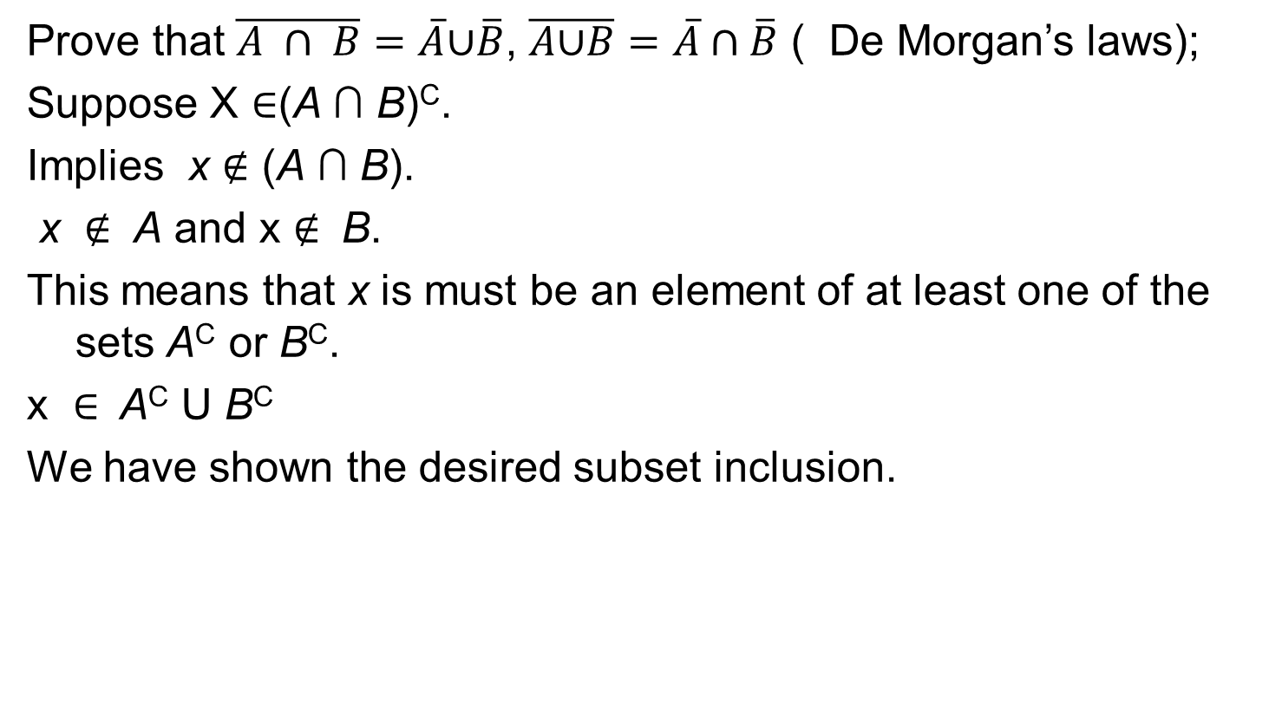
Problems
Prove that $\overline{A ∩ B}=\overline{A}\text{∪}\overline{B}$, $\overline{A\text{∪}B}=\overline{A}∩\overline{B}$ ( De Morgan’s laws);
Suppose X $∈$(A ∩ B)^{C}.
Implies x $∉$ (A ∩ B).
x $∉$ A and x $∉$ B.
This means that x is must be an element of at least one of the sets A^{C} or B^{C}.
x $∈$ A^{C} U B^{C}
We have shown the desired subset inclusion.

Slide 4
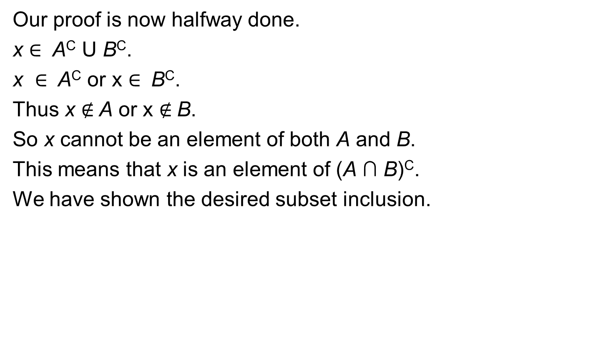
proof
Our proof is now halfway done.
x $∈$ A^{C} U B^{C}.
x $∈$ A^{C} or x $∈$ B^{C}.
Thus x $∉$A or x $∉$B.
So x cannot be an element of both A and B.
This means that x is an element of (A ∩ B)^{C}.
We have shown the desired subset inclusion.

Slide 5

Problem
A$⊕$B=(A−B)∪(B−A)
Proof.
A $⊕$B=(A∪B)−(A∩B)
=(A∪B)∩(A∩B)′
=(A∪B)∩(A′∪B′)=
((A∪B)∩A′)∪((A∪B)∩B′)
=(B∩A′)∪(A∩B′)
=(B−A)∪(A−B).

Slide 6
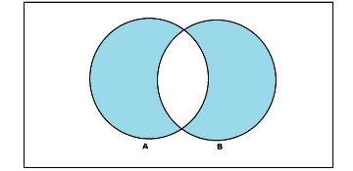
Problems
Draw venn diagram of the symmetric difference of the sets.
Draw venn diagram of (A-B)U(A-C)U (B-C).
Prove the distributive law.

Slide 7
Distributive law
S ∪ (T ∩ R)= (S ∪ T) ∩ (S ∪ R).
For the first inclusion, we will assume that x ∈ S ∪ (T ∩ R). Thus, x ∈ S or x ∈ T ∩R, giving us two cases.
If x ∈ S, then x ∈ S ⊂ S ∪T and x ∈ S ⊂ S ∪R. Thus, since x is in both sets, it is in the intersection: x ∈ (S ∪ T) ∩ (S ∪ R).
In the second case, we let x ∈ T ∩ R. Thus, x ∈ T and x ∈ R are both true. Since x ∈ T, then x ∈ T ⊂ S ∪ T. Since x ∈ R, then x ∈ R ⊂ S ∪ R.
Since x is in both sets, it is in the intersection: x ∈ (S ∪ T) ∩ (S ∪ R). Thus, in either of our two cases, we conclude that x ∈ (S ∪ T) ∩ (S ∪ R). So, we have obtained the subset inclusion: S ∪ (T ∩ R) ⊂ (S ∪ T) ∩ (S ∪ R).

Slide 8
Cont.
we will assume that x ∈ (S ∪ T) ∩ (S ∪ R).
Thus, we know that x ∈ S ∪ T and also x ∈ S ∪ R. Since x ∈ S ∪ T, then x ∈ S or x ∈ T; furthermore, since x ∈ S ∪ R, then x ∈ S or x ∈ R. So, at least one of x ∈ S or x ∈ T has to be true while, at the same time, at least one of x ∈ S or x ∈ R must be true. If we know that x ∈ S, then x ∈ S ⊂ S ∪ (T ∩ R).
If it’s not true that x ∈ S, then it must be that x ∈ T and that x ∈ R. Thus, x ∈ T ∩R and thus x ∈ (T ∩R) ⊂ S ∪(T ∩R). So, we have the subset inclusions (S ∪ T) ∩ (S ∪ R) ⊂ S ∪ (T ∩ R).
Since we have shown both inclusions to be true, then we can conclude the two sets are equal: S ∪ (T ∩ R) = (S ∪ T) ∩ (S ∪ R).

Slide 9
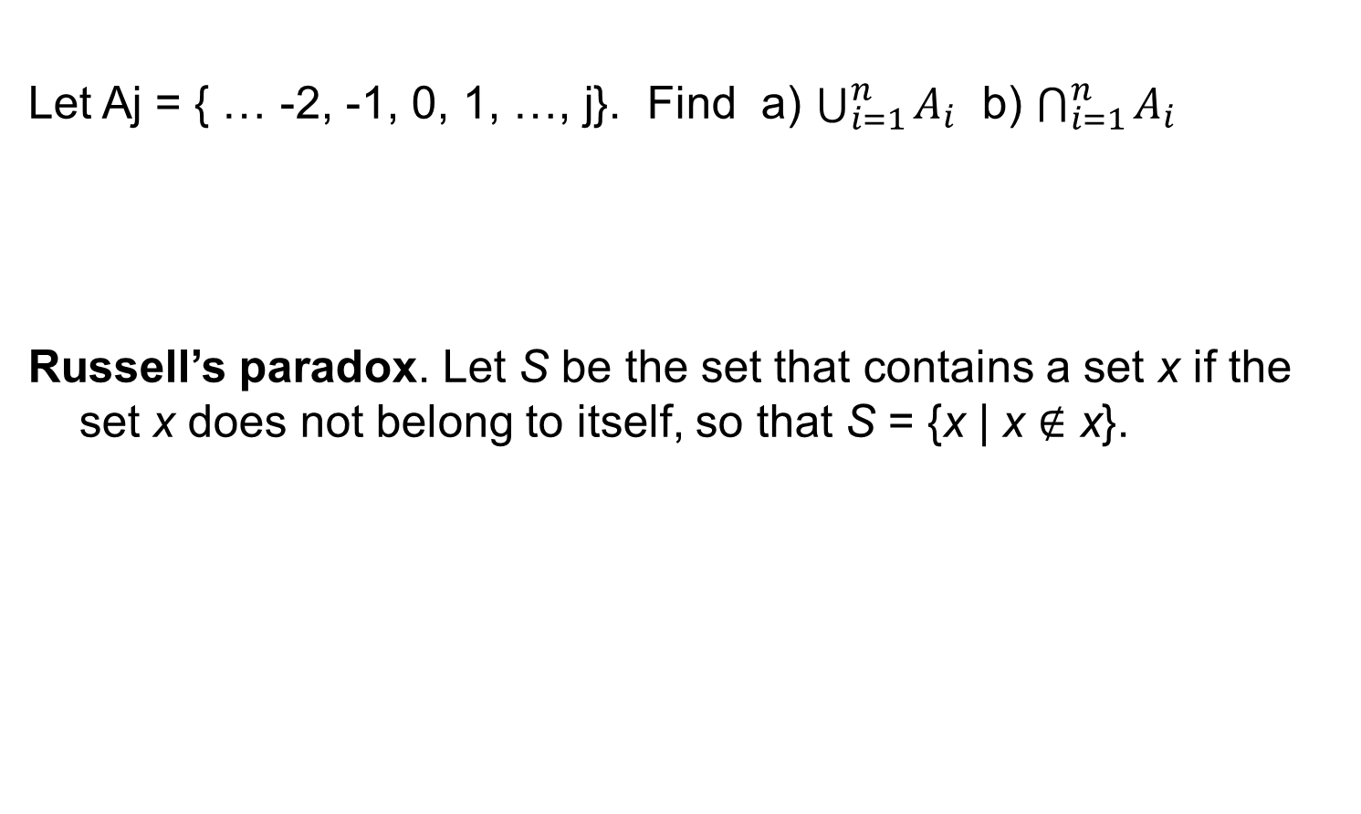
Problems
Let Aj = { … -2, -1, 0, 1, …, j}. Find a) $\bigcup_{i=1}^{n}{A_{i}}$ b) $\bigcap_{i=1}^{n}{A_{i}}$
Russell’s paradox. Let S be the set that contains a set x if the set x does not belong to itself, so that S = {x | x $∉$ x}.

Slide 10
Functions

Slide 11
Definitions and notation
Let A and B be nonempty sets.
A function f from A to B is an assignment of exactly one element of B to each element of A.
We write f (a) = b if b is the unique element of B assigned by the function f to the element a of A.
If f is a function from A to B, we write f : A → B.

Slide 12
Notations
If f is a function from A to B, we say that A is the domain of f and B is the codomain of f.
If f (a) = b, we say that b is the image of a and a is a preimage of b.
The range, or image, of f is the set of all images of elements of A.
Also, if f is a function from A to B, we say that f maps A to B.

Slide 13
Definition
Let f₁ and f₂ be functions from A to R.
Then f₁ + f₂ and f₁f₂ are also functions from A to R defined for all x ∈ A by
(f₁ + f₂)(x) = f₁(x) + f₂(x),
(f₁f₂)(x) = f₁(x)f₂(x).

Slide 14

Definitions
A function f is said to be one-to-one, or an injunction, if and only if f (a) = f (b) implies that a = b for all a and b in the domain of f.
A function is said to be injective if it is one-to-one.
Remark: ∀a, ∀b (a $≠$ b → f (a) $≠$ f (b)), where the universe of discourse is the domain
of the function.

Slide 15
Increasing an decreasing functions
A function f whose domain and codomain are subsets of the set of real numbers is called increasing if f (x) ≤ f (y), and strictly increasing if f(x) < f(y), whenever x < y and x and y are in the domain of f.
Similarly, f is called decreasing if f (x) ≥ f (y), and strictly
decreasing if f(x) > f(y), when ever x < y and x and y are in the domain of f. (The word strictly in this definition indicates a strict inequality.)

Slide 16
Onto function
A function f from A to B is called onto, or a surjection, if and only if for every element b ∈ B there is an element a ∈ A with f (a) = b.
A function f is called surjective if it is onto.

Slide 17
Different functions

Slide 18
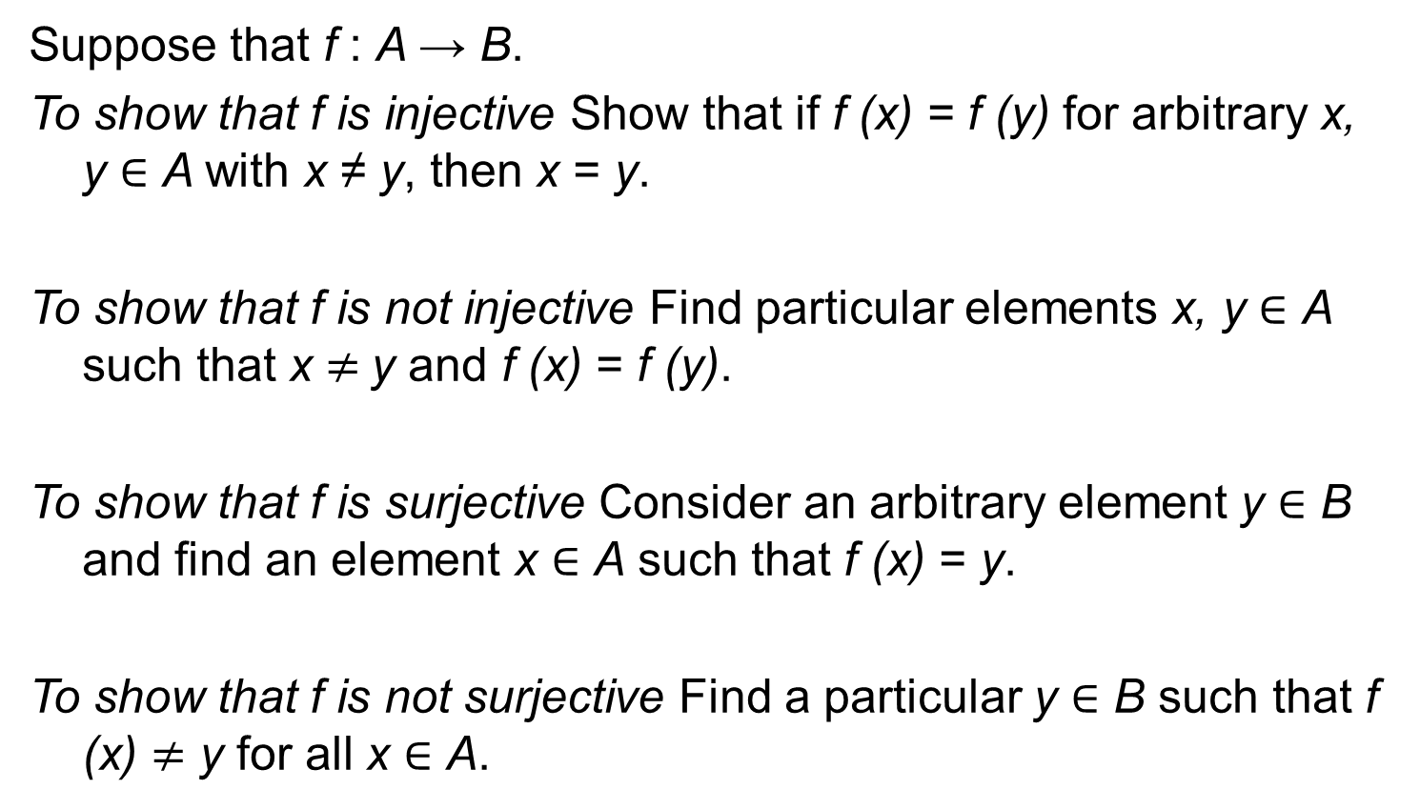
Fact to prove:
Suppose that f : A → B.
To show that f is injective Show that if f (x) = f (y) for arbitrary x, y ∈ A with x ≠ y, then x = y.
To show that f is not injective Find particular elements x, y ∈ A such that x $≠$y and f (x) = f (y).
To show that f is surjective Consider an arbitrary element y ∈ B and find an element x ∈ A such that f (x) = y.
To show that f is not surjective Find a particular y ∈ B such that f (x) $≠$ y for all x ∈ A.

Slide 19
Defintions
The function f is a one-to-one correspondence, or a bijection, if it is both one-to-one and onto.
We also say that such a function is bijective.

Slide 20
Definiton
Let f be a one-to-one correspondence from the set A to the set B. The inverse function of f is the function that assigns to an element b belonging to B the unique element a in A such that f (a) = b.
The inverse function of f is denoted by f ⁻¹.
Hence, f⁻¹(b) = a when f (a) = b.

Slide 21
Defintion
Let g be a function from the set A to the set B and let f be a function from the set B to the set C.
The composition of the functions f and g, denoted for all a ∈ A by f ◦ g, is defined by (f ◦ g)(a) = f (g(a)).

Slide 22
Floor and ceiling functions
The floor function assigns to the real number x the largest integer that is less than or equal to x. The value of the floor function at x is denoted by x. The ceiling function assigns to the real number x the smallest integer that is greater than or equal to x. The value of the ceiling function at x is denoted by x.

Slide 23
Properties of Floor and Ceiling functions

Slide 24
Graph
Let f be a function from the set A to the set B. The graph of the function f is the set of ordered pairs {(a, b) | a ∈ A and f (a) = b}.
.

Slide 25
One to one example
Determine whether each of these functions from ℤ to ℤ is one-to-one a) ƒ(n) = n – 1
This function maps each value in ℤ to a unique image, therefore it is one-to-one.
b) ƒ(n) = n² + 1
The values 2 and -2 map to the same image in ℤ, therefore it is not one-to-one.
c) ƒ(n) = n³
This function maps each value in ℤ to a unique image, therefore it is one-to-one.
d) ƒ(n) = ⌈n/2⌉
The values 3 and 4 map to the same image in ℤ, therefore it is not one-to-one.

Slide 26
Onto example
Determine whether each of these functions from Z to Z is onto (surjective).
f(n) = n − 1
This is surjective since every integer is 1 less than some integer.
b) f(n) = n ² + 1
Not surjective because the range cannot include negative integers.
f(n) = n³
Not surjective because any element in the codomain that is not a perfect cube will not be mapped to

Slide 27
Problem
Give an example of a function from N to N that is
a) one-to-one but not onto.
b) onto but not one-to-one.
c) both onto and one-to-one (but different from the identity
function).
d) neither one-to-one nor onto.
Solution :
One possible solution is:
i. f(x)=2x
f(x)=f(y)⇒2x=2y⇒x=y So f is one-to-one. There is no x∈N such that 2x=1, so f is not onto.

Slide 28
Sol.
ii. f(1)=1 and f(x)=x−1 if x>1 f(1)=f(2)=1, so f is not one-to-one. ∀x∈N f(x+1)=x, so f is onto.
iii. f(x)=x
iv. f(x)=1 f(1)=1=f(2), so f is not one-to-one. There is no x∈N such that f(x)=2, so f is not onto.

Slide 29
Problem
Determine whether each of these functions is a bijection
from R to R.
a) f (x) = −3x + 4
b) f (x) = −3x² + 7
c) f (x) = (x + 1)/(x + 2)
d) f (x) = x⁵ + 1

Slide 30
Inverse of a function example and composite function
Let f be the function from R to R defined by
f (x) = x². Find
f⁻¹({1}).
f⁻¹({x | 0 < x < 1}).
c) f⁻¹({x | x > 4}).
Given the following functions f and g, from R to R, find f ◦ g.
f(x) = x ² g(x) = x + 1
f ◦ g=(f(g(x)) = f(x + 1) = (x +1)²

Slide 31
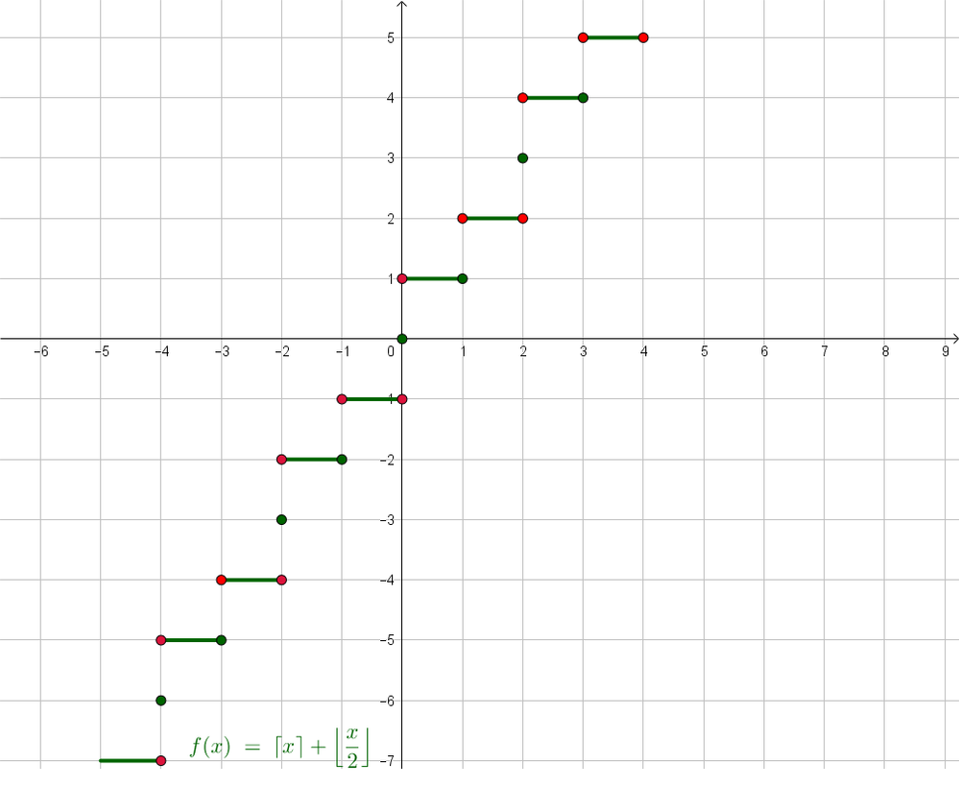
Graph of a function

